Slide 1


A SURVEY ON ATTACK METHODS ON MACHINE LEARNING MODELS TO INCREASE THE EFFICIENCY IN DETECTION OF FAKE NEWS
MASTERS OF ANALYTICS (RESEARCH)
BY VISHAL UNIYAL
SID 12103584
Notes:
Introduce
Studying – 2 years
Previously done bachelors of software
I have worked as IT systems analyst for 3 years
The topic is A SURVEY ON ATTACK METHODS ON MACHINE LEARNING MODELS TO INCREASE THE EFFICIENCY IN DETECTION OF FAKE NEWS

Slide 2
TABLE OF CONTENT
Introduction – Fake News and Machine Learning
Motivation – Adversarial Attack and Spam Classification
Background
Fact Checking and Generating Fake News
Classification Techniques
Transferable Attacks
Future Research Opportunities
Progress Report
Notes:
We will talk about what is fake news and what is machine learning and the impacts
How and why it has motivated to me to take up this topic,
Briefly talk about the back ground of fake new detection.
What types are fact checking and what are fake news generators
Transferability of attacks in simple terms reach the highest efficiency
Future research opportunities & progress report

Slide 3
INTRODUCTION
COMPREHENSIVE REVIEW ON FAKE NEWS AND NEURAL NETWORKS
Notes:
So lets start of this survey with fake news

Slide 4
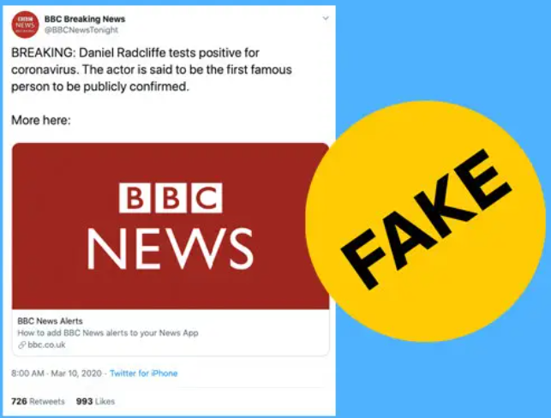

WHAT IS FAKE NEWS?
Notes:
On January 20 post floated that the millimeter wave spectrum used by 5G technology and Covid-19. The article was taken down within hours, but the theory had already spread to English-language Facebook pages. There’s been a crowd that has been saying that 5G is harmful to human health for years, ever since 5G was first being proposed [and] well before any towers or networks were online

Slide 5
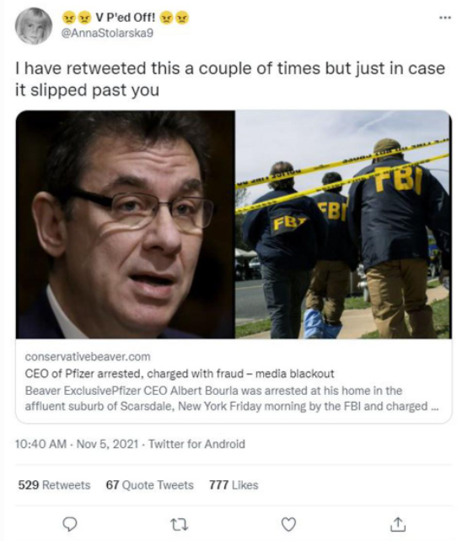
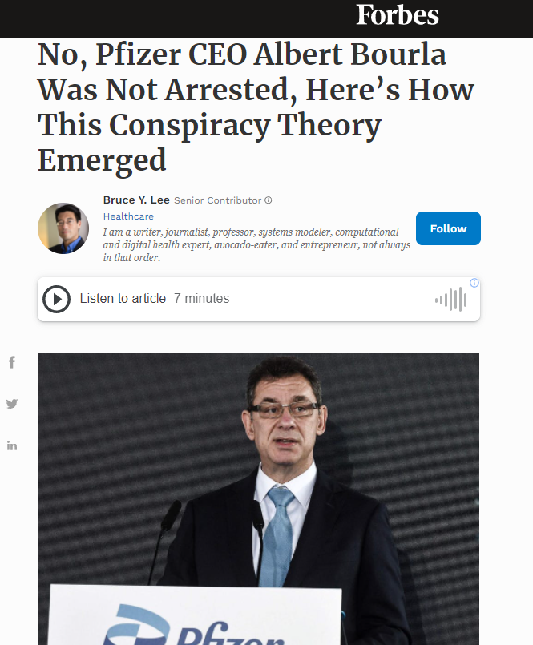
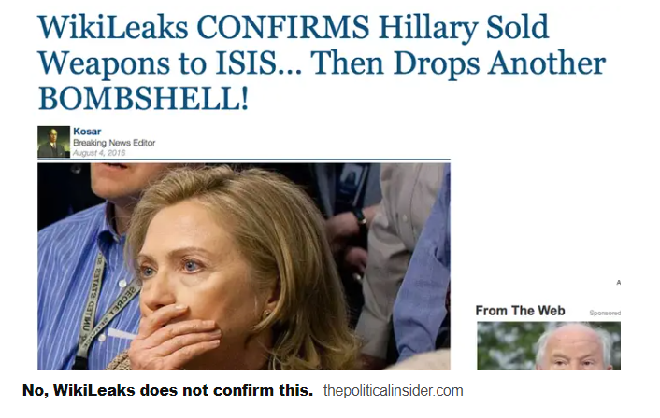
FAKE NEWS
“false stories that appear to be news, spread on the Internet or using other media, usually created to influence political views or as a joke”**
EXAMPLES
FAKE
Actual
**Fake News. (2018). In Cambridge online dictionary. Retrieved from https://dictionary.cambridge.org/us/dictionary/english/fake-news
Notes:
Fake news is false stories that appear to be news, spread on the Internet or using other media, usually created to influence political views or as a joke.
Hillary Clinton sold weapons to ISIS and it was confirmed by WikiLeaks This stemmed from a number of social media users who posted that one of the Wikileaks emails from "The Podesta Emails" proved Hillary Clinton had "sold weapons to ISIS,“ there were just ordinary set of emails sent by hilary Clinton, Hillary Clinton suggested Trump should run for President which obviously she didn’t say but it did create a stir in the social media.
We have another Fake news article shared on twiter stating CEO of Pfizer has been arrested and charge with fraud - CEO Albert Bourla was arrested for misrepresenting the effectiveness of his company’s vaccine. Then you have another news that

Slide 6
ENGAGEMENTS OF FAKE NEWS
FAKE NEWS Articles | Publishing Website | Engagements | Impact
Obama signs a nationwide order banning The Pledge of Allegiance in Schools | abcnews.com.co | 2.2 million | Defaming US Democratic Party during elections
Obama cut $2.6 billion from programs for vet-erans to support Syrian refugees in the US | endingthefed.com | 1.7 million | Defaming US Democratic Party during elections
Ireland is officially accepting Trump refugees from America | winningdemocrats.com | 817,900 | Loss of Political Stance and leadership toward republicans
Hillary Clinton sold weapons to ISIS and it was confirmed by WikiLeaks | thepoliticalinsider.com | 789,500 | Change in election stance
Daniel Radcliffe Tests Positive for Corona Virus | BBC.com | 762,000 | Loss of reliability of Popular news channels

Slide 7
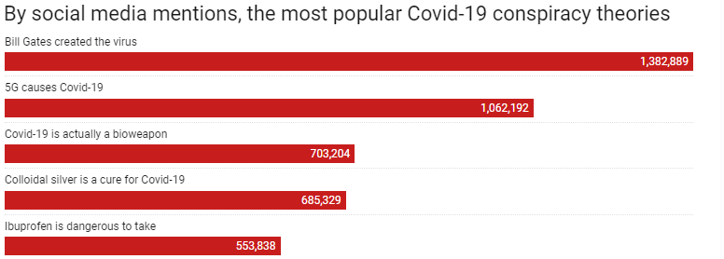
Heilweil, R. (2020, April 24). The conspiracy theory about 5G causing coronavirus, explained. Vox. https://www.vox.com/recode/2020/4/24/21231085/coronavirus-5g-conspiracy-theory-covid-facebook-youtube
COVID-19 FAKE NEWS & ENGAGEMENTS
Notes:
This data includes social media information collected between January 1, 2020 and April 20, 2020.

Slide 8
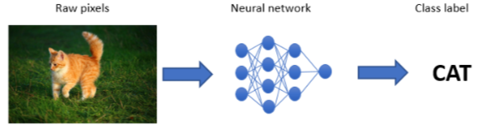

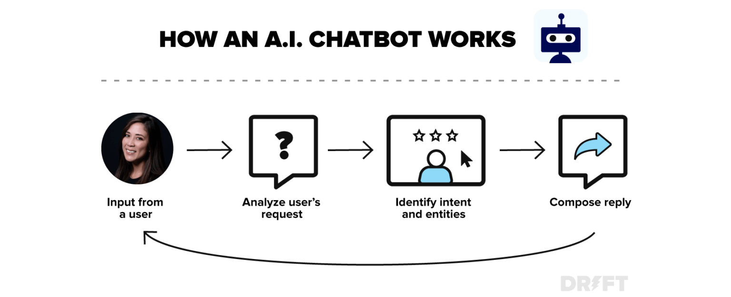
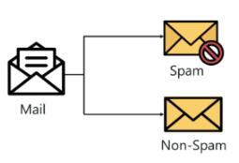
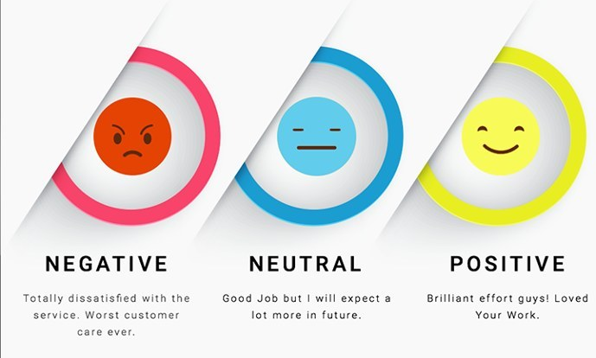
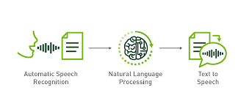
DEEP NEURAL NETWORKS
An artificial neural network (ANN) is an aspect of AI that is focused on emulating the learning approach that humans use to gain certain types of knowledge. Like biological neurons, which are present in the brain, ANN also contains several artificial neurons, and uses them to identify and store information
Image Classification
Chatbots
Spam Filtering
Sentimental Analysis
Speech ← Text
Notes:
We have some Natural processing language techniques used and some are used in our day to day lives,
so we have Image classification where there is a picture of a cat but for computer vision is just array of pixels but fed into a neural network which is able to label it in text.

Slide 9
MOTIVATION

Slide 10

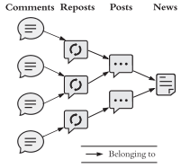
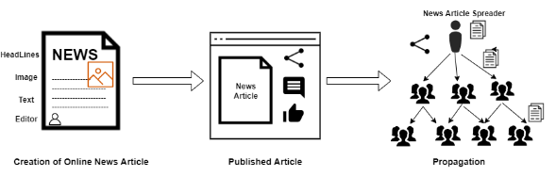
MOTIVATION: ACHIEVING DEFENSIVE DISTILLATION OF MODEL
Building Robust Classifier: With the help of adversarial learning and modern-day ML detect practices, my goal is to build a model that can efficiently detect through new fake news articles and question their originality.
Spam Detection: Enable other researcher to use this knowledge to implement in Spam detection. Spam detecting is in many ways like Fake News Article Detection technique.
Awareness: Spreading awareness to the readers and help them utilize this feature of fake news detection derecognize the originality and severity of the content.
It is essential identify fake news articles to eliminate it’s Impacts.
Implement a detection application to classify fake news.
Identify Exclusive or Latest News articles without relaying heavily on past News datasets.
Implement Adversarial Learning techniques to Boost the efficiency of the classifiers.
Notes:
The purpose of this study is to detect fake news more efficiently than prevailing detection techniques can. As I read current day research, I found detection strategy insufficient for accurately finding fake news article online. As world’s technical sector is advancing current day techniques are becoming easy to spread false rumors, misinformation and deception without getting detected. Adversarial Learning techniques are modern techniques, these training ML Models have show the highest accuracy in predicting outcome. I have decided to take use Adversarial learning methodology with current day fake news detection technique

Slide 11
BACKGROUND

Slide 12
HOW DO YOU FACT CHECK?
Manual Fact-Checking
Automatic Fact-Checking
Expert Fact-Checking (PolitiFact, Gossip Cop) Creation of LIAR & FakeNewsNet Dataset
Crowd Fact-Checking (CREDBANK)
SPO – Subject Predicate Object (Redundancy)
Divided into Fact Extraction & Fact Checking
Notes:
Manual fact-checking can be classified into two categories: (I) expert-based and (II)crowd-sourced fact-checking

Slide 13
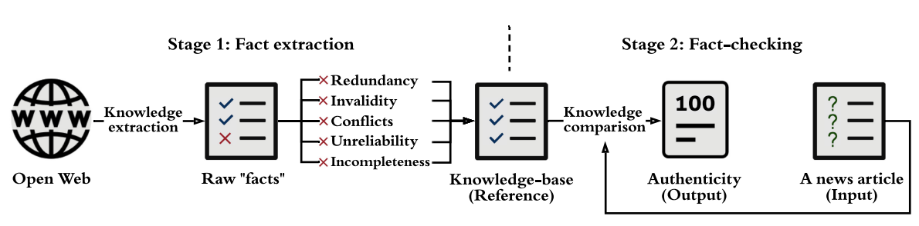
AUTOMATIC FACT CHECKING
Fact Extraction
Single Source (Wikipedia) or Open-Source (other News Articles)
Defining time intervals for the incident, Redundancy, Conflicts by Multi criteria Decision Making (MCDM)
Ensuring Relibility of News source & ensuring completeness of extracted knowledge.
Fact Checking
compare the knowledge extracted from to-be-verified news content (i.e., SPO triples) with facts
Where SPO triples (si,pi, oi ), i = 1, 2,...,n, GKB = true knowledge, Ai ∈ [0, 1] indicates true or False
F : (s_{i}, p_{i}, o_{i} ) G_{KB}→ A_{i}, In vectorize comparision with (s_{tj} ,p_{tj} , o_{tj} ), j = 1, 2,...,m.
A = I(A₁,A₂,...,A_{n} ), where I is a weight function.
F ((s_{i}, p_{i}, o_{i} ),G_{KB}) = P (edge labelled pi linking s’_{i} to o’_{i} in G_{KB}), where P() = probability
EXAMPLE of Fact Extraction –
(DonaldTrump, bornIn, NewYorkCity) Vs (DonaldTrump, bornIn, LosAngeles) – Conflicts
(Britain, joinIn, EuropeanUnion) – Invalidity
(DonaldJohnTrump, profession, President) Vs (Donald- Trump, profession, President) Redundancy
s’_{I} = arg min |D(s_{i}, s_{tj})| < θ and o’_{I} = arg min |D(o_{i}, o_{tj})| < θ
Where D(a, b) is a cosin distance, if D(a,b) = 0, a as the same entity as b
Xinyi Zhou and Reza Zafarani. 2020. A survey of fake news: Fundamental theories, detection methods, and opportunities.ACM Computing Surveys(CSUR)53, 5 (2020), 1–40.
Notes:
extracted raw “facts,” they need to be further cleaned up and completed by addressing Redundancy Invalidity, Conflicts, unreliability and Incompleteness.
(DonaldTrump, bornIn, NewYorkCity) Vs (DonaldTrump, bornIn, LosAngeles) – Conflicts
(Britain, joinIn, EuropeanUnion) – Invalidity
(DonaldJohnTrump, profession, President) Vs (Donald- Trump, profession, President) Redundancy
SPO triples (si,pi, oi ),i = 1, 2,...,n. Let GKB refer to a KG containing a set of facts (i.e., true knowledge) denoted by (stj ,ptj , otj ), j = 1, 2,...,m.

Slide 14

PROBLEM WITH FACT CHECKING

Slide 15

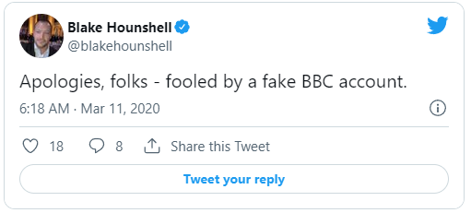
UNRELIABLE, BIASED & WAY TOO MANY NEWS
Expert based:
Detailed analysis takes time
Cost ineffective
Inability to cope up with News Generators.
Crowd Based:
Harder to administer
Less credible
Less accurate due to fact-checkers’ political bias and contradicting annotations.
Automatic Fact Checking:
Who administers Source Knowledge base? Wikipedia and BBC news ->>
Inaccuracy in checking exclusive News articles.
Wong, Q. (2020, March 10). Twitter users duped by fake account that falsely claimed Daniel Radcliffe has coronavirus. CNET. https://www.cnet.com/news/twitter-users-duped-by-fake-account-that-falsely-claimed-daniel-radcliffe-has-coronavirus/

Slide 16
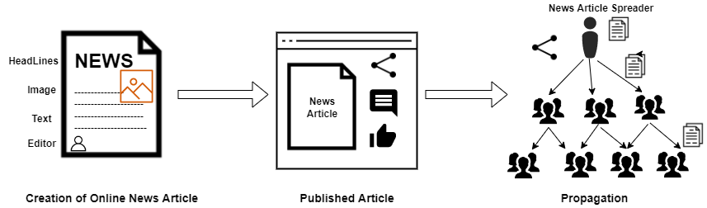
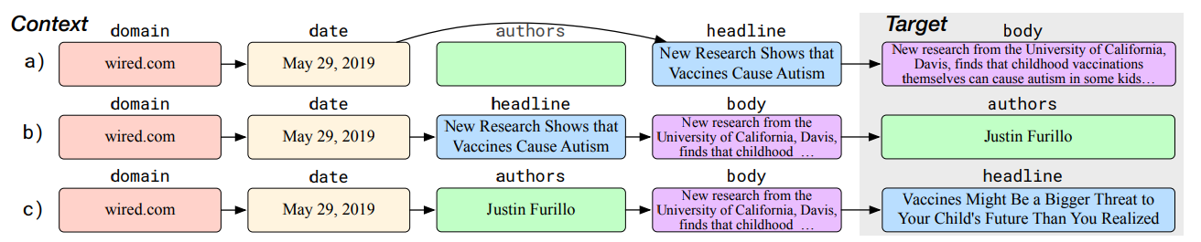
FAKE NEWS GENERATORS
Traditional Manual Article Creation
Manual Article Life Cycle
Grover: Generates both realistic and controlled generation
Providing Meta Data such as domain, a date, and a headline.
Grover-Base, has 12 layers and 124million parameters, on par with BERT-Base
Common Crawl dumps and restricting to the 5000 news domains indexed by Google News.
Article can be modelled by joint distribution –
P(domain, date, authors, headline, body)
A diagram of three Grover examples for article generation. In row a), the body is generated
from partial context (the authors field is missing). In b), the model generates the authors. In c), the
model uses the new generations to regenerate the provided headline to one that is more realistic
Notes:
Recently introduced large-scale generative models produce realistic-looking text but they do not lend themselves to producing controllable generations, Grover Does both.
Grover-Base, has 12 layers and 124million parameters, on par with BERT-Base
Here is an example of using Grover to generate an anti-vaccine article. Here, the adversary specifies a domain, date, and headline. After Grover generates the body, it can be used to generate a fake author, before finally generating a new and more appropriate headline
GROVER is not only a generator model but initially It was a Detection model

Slide 17
FAKE NEWS DETECTION TECHNIQUES

Slide 18
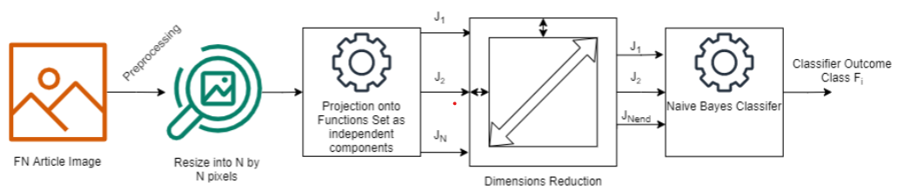
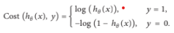
TRADITIONAL ML TECHNIQUES
Logistic Regression: Estimates probabilities of Fake or Original article
Support Vector Machine (SVM): binary classification problem in a hyperplane by declaring many features in an N-Dimensional Space.
K-Nearest Neighbors (KNN): estimating the nearest distance class.
Naive Bayes Classifier: a frequently occurring attribute.
Bagging Ensemble Classifiers (Decision tree): total estimations of votes.
Multilayer Perceptron (MLP): An ANN with an input layer,one or more hidden layers, and an output layer.
F(x) = g(b² + W² (s(b¹ +W¹x))). Where b(1) and b(2) are the bias vectors, W(1) and W(2) are the weight matrices, and g and s are the activation functions.
LR Cost Function, Where H() is hypothesis function
Naive Bayes Classifier for Image Detection
Notes:
LR :.
SVM:
Multilayer Perceptron.

Slide 19
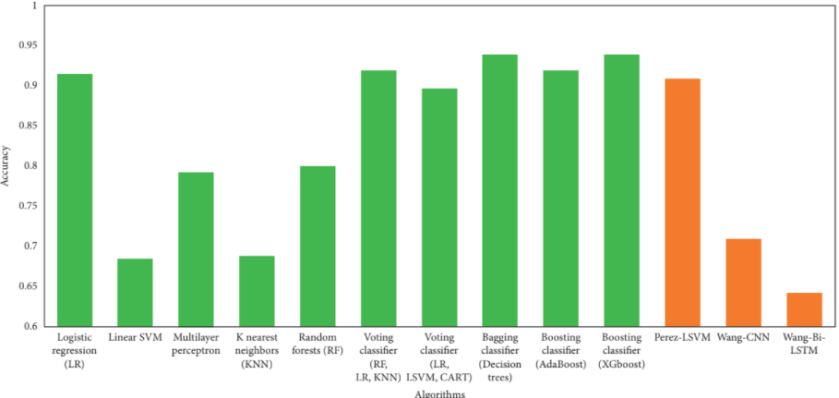
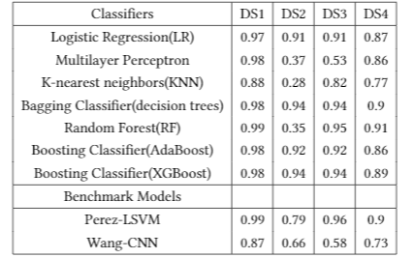
EFFICIENCY OF TRADITIONAL CLASSIFIERS
Accuracy = TP + TN/(TP+TN+FP + FN)
Efficiency of the Classifiers
Notes:
d
boosting classifier (XGBoost) are the best performing algorithms, achieving an accuracy of 94%. Interestingly, linear
SVM, random forest, and Perez-LSVM performed poorly on DS2. Individual learners reported an accuracy of 47.75%, whereas ensemble learners’ accuracy is 81.5%.

Slide 20
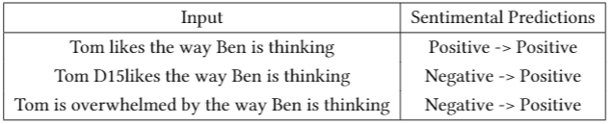
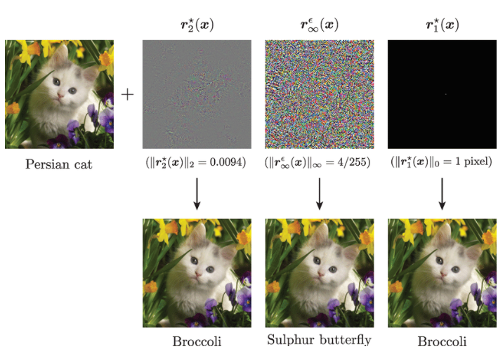
WHAT DOES IT LACK?
Adversarial Examples in Sentimental Analysis
Vulnerable to Adversarial attacks.
Hotflip
Sentimental Analysis
Image perturbation
Speech to text Detection.
Optical Character Recognition.
Lack of dataset & True Facts
Adversarial perturbations on images
Notes:
Illustration of different additive adversarial perturbations ( 1 , , 2 and ∞ ) (top) and the corresponding adversarial examples (bottom) that fool a state-of-the-art deep neural network. The norm of each perturbation is indicated below the corresponding image, except for the 1 perturbation (sparse) where the number of perturbed pixels is provided.

Slide 21

FUTURE RESEARCH OPPORTUNITIES

Slide 22
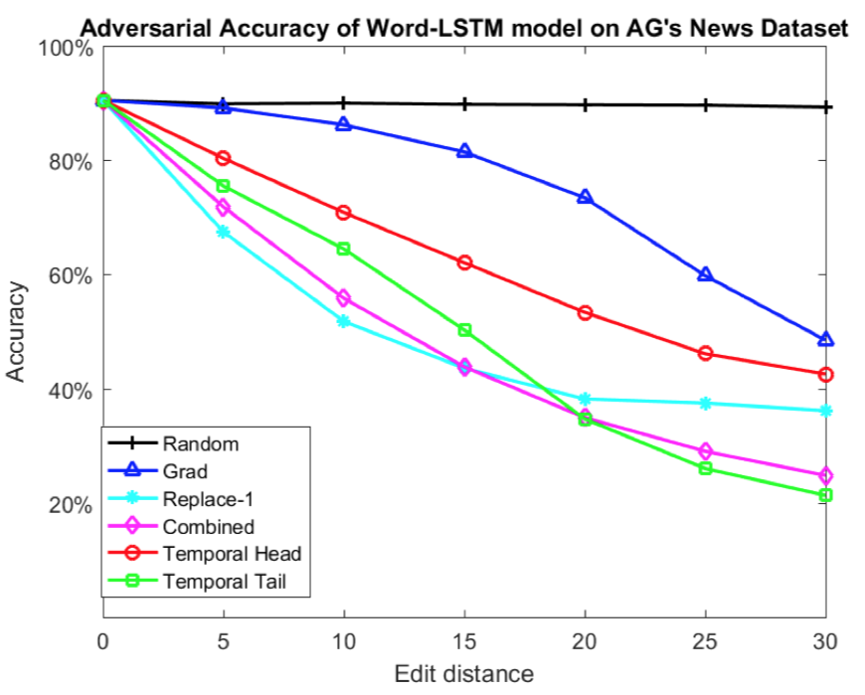
ATTACK MODEL : ADVERSARIAL LEARNING
Text Classification
Deep learning algorithms for text classification were used to target a vulnerability.
DeepWord-Bug, a tool that exploits this flaw to generate adversarial text sequences that can deceive deep learning models, was presented.
Following are the outcomes:
(i) Black-box: DeepWordBug creates adversarial samples in completely black-box style.
(ii) Performance: DeepWordBug outperforms baseline approaches on eight NLP datasets using two state-of-the-art deep learning architectures: Word-LSTM and Char-CNN.
DeepWordBug resulted in 68% in average classification accuracy for a word-level LSTM model and 48% decrease in average for character-level CNN model.
It was proved that utilising DeepWordBug samples in training data improves model accuracy on generated adversarial samples from 12 % to around 62%.

Slide 23
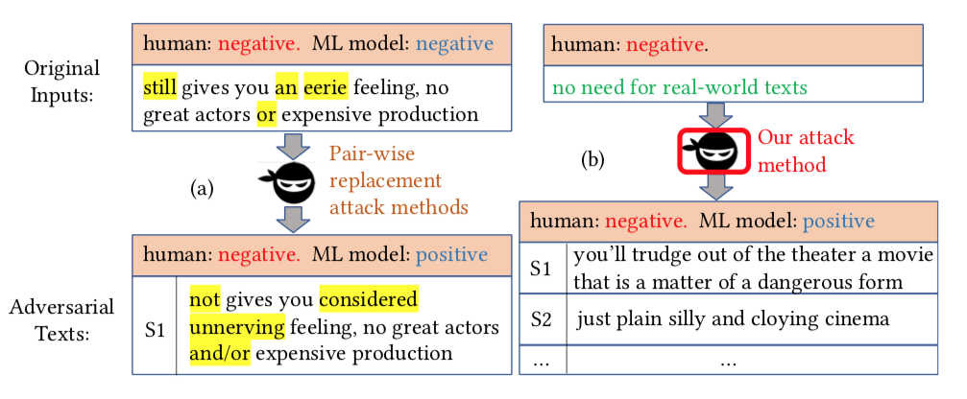
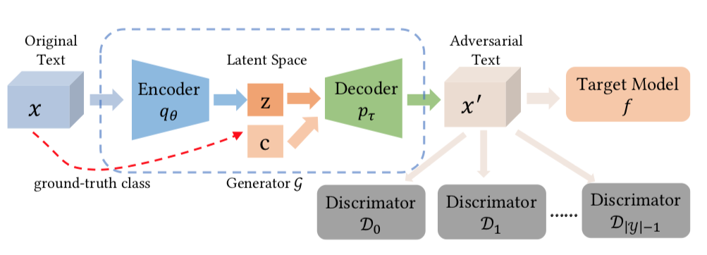
ATTACK MODEL : ADVERSARIAL LEARNING
(contd/-....)
Sentiment Analysis
(a) Given one negative text, traditional methods replace a few words (yellow background) which is still negative for humans, but the model pre-diction changes to positive.
(b) Research method can generate large-scale adversarial texts which are negative for humans, but classified as positive by the ML model.
As the target model, the TextCNN model was used.
Two popular public benchmark datasets were used in the experiments:
(i) Movie Reviews on Rotten Tomatoes (RT).
(ii) The Internet Movie Database.
3. Experiments were carried out in two ways:.
(i) Examine the performance of the researcher's model for changing an existing input text into an adversarial one using the prevalent parameters.
(ii) Strategy for creating unrestricted adversarial texts from start was also reviewed.
After trained, the model can generate large-scale adversarial texts based on sampled latent space vector z and a chosen class c without original texts x.
Notes:
As the target model, the TextCNN model was used.
Two popular public benchmark datasets were used in the experiments:
(i) Movie Reviews on Rotten Tomatoes (RT). Dataset contained 5, 331 analysed positive and negative movie reviews. The training set was made up of 80% of the dataset, 10% was used for development, and 10% was used for testing.
(ii) The Internet Movie Database. Dataset includes 50,000 movie reviews gathered from online movie review sites. Training set was made up of 20% of the dataset.
Experiments were carried out in two ways:.
(i) Examine the performance of the researcher's model for changing an existing input text into an adversarial one using the prevalent parameters. Research approach was found to have a greater attack success rate, generate fluent sentences, and more efficient.
(ii) Strategy for creating unrestricted adversarial texts from start was also reviewed. The created adversarial texts were largely correct, and they could be used to improve the robustness of text categorization models significantly

Slide 24
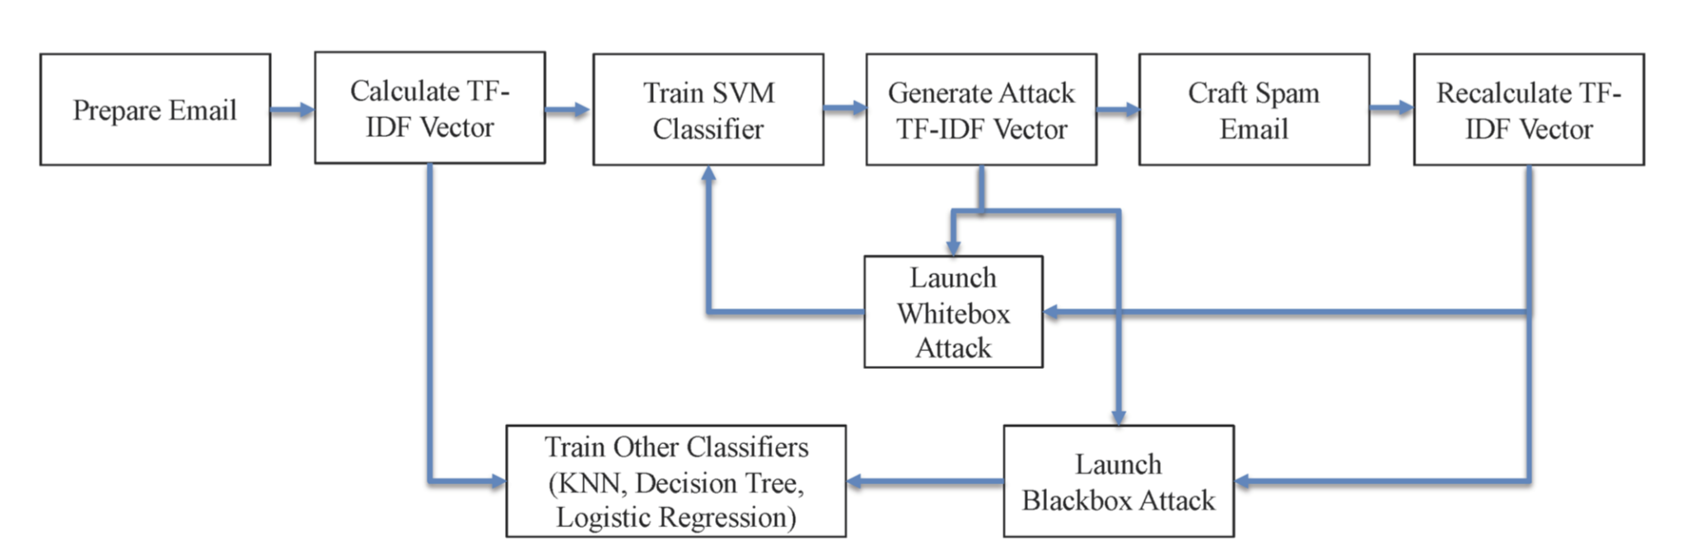
ATTACK MODEL : ADVERSARIAL LEARNING
(contd/-....)
Spam Detection
Two novel text crafting techniques were developed:
(i) To estimate the TF-IDF values.
(ii) Add special words to the original emails.
Enron-Spam dataset provided 17,171 spam emails and 16,545 regular emails.
PGD was run on SVM, KNN, Decision Tree and Logistic Regression to perturb randomly selected spam emails in both white-box and black-box attack scenarios.
Second method of adding special words was more effective in terms of the attack success rate against all the three classifiers.
Workflow of Generating Adversarial Perturbations, Crafting Adversarial Emails, and Conducting Attacks
Notes:
Two novel text crafting techniques were developed to enhance the attack effectiveness by using adversarial perturbations caused by adversarial sample generation algorithms:
(i) To estimate the TF-IDF values.
(ii) Add special words to the original emails.

Slide 25
ATTACK MODEL : ADVERSARIAL LEARNING
(contd/-....)
Optical Character Recognition
Tesseract was chosen for the experiment.
By causing the OCR model to misrecognize a few key words.
Researchers used papers from the publicly available corpus of Hillary Clinton's emails. Following strategies were employed:
(i) Changing crucial data in text.
(ii) Modification of text's semantic meaning.
(iii) The attack has a major impact on NLP applications that use OCR as a preprocessing step.
Algorithm 1 Generating target text for NLP classifier:
1: Input: NLP classifier h, victim text t, vocabulary V, edit-distance threshold τ, model failure criterion
2: Output: Modified target text t⋆ or failure ⊥
3: R←0/ ◃set of word replacements
4: for each word w in x do
5: W ←{w′|w′ ∈V,edit-distance(w,w′)≤τ}
6: T ←{t′|t with w replaced by w′,w′ ∈W}
7: ∆ ← {δ|δ = h(t′)−h(t),t′ ∈ T}
8: if min ∆ < 0 then
9: w′ ← word replaced in argmin t ∆ δ ←min∆
10: R ← R ∪ {(w,w′,δ)}
11: end if
12: end for
13: Sort R by absolute value of δ in descending order.
14: t⋆←t
15: for (w,w′,δ)∈ R do
16: Replace w in t⋆ with w′
17: if h(t⋆) meets model failure criterion then
18. return t⋆
19: end if
20: end for
21: return⊥
Notes:
Tesseract was chosen for the experiment because it is one of the most widely used open-source OCR systems and because a trained model is available.
By causing the OCR model to misrecognize a few key words, this attack changes the meaning of the resulting text.
Researchers used papers from the publicly available corpus of Hillary Clinton's emails in the experiment to demonstrate how the attack works for photos of complete documents.
Following strategies were employed:

Slide 26
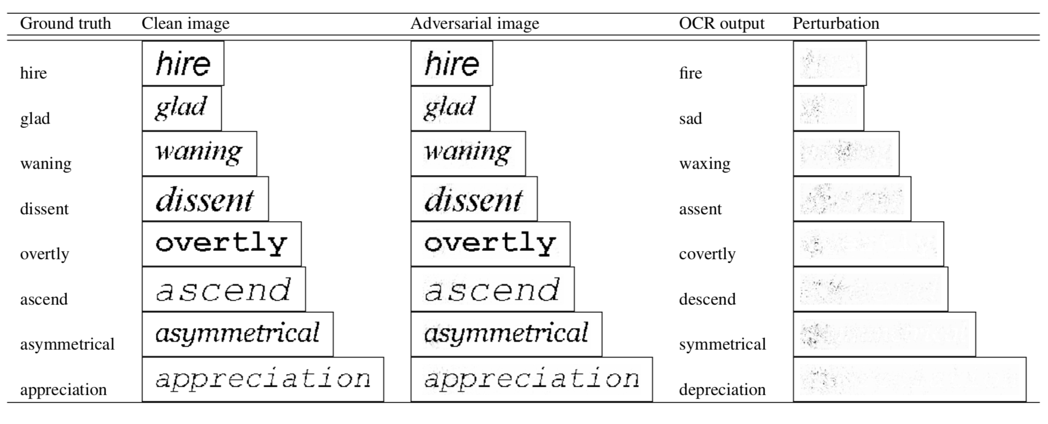
ATTACK MODEL : ADVERSARIAL LEARNING
Optical Character Recognition (contd/-....)
Generating adversarial text for NLP models.
Generating adversarial text images.
Data poisoning attacks
Adversarial renderings of words misrecognized as their antonyms by Tesseract. Perturbation is absolute difference between clean and adversarial images.
Notes:
Generating adversarial text images. We first render a clean image based on the original text t. We run Algorithm 1 on t to obtain the adversarial text t⋆. We then locate the lines of the clean image where the texts needs to be modified. As in the basic attack, we generate the adversarial examples for these lines and replace the orig- inal lines with the generated images.
(c) Data poisoning attacks. OCR is often used as a prepro- cessing step for collecting raw data to train NLP models Our attack can contaminate the raw text im- ages used as part of the training data and thus affect the performance of the trained model.

Slide 27
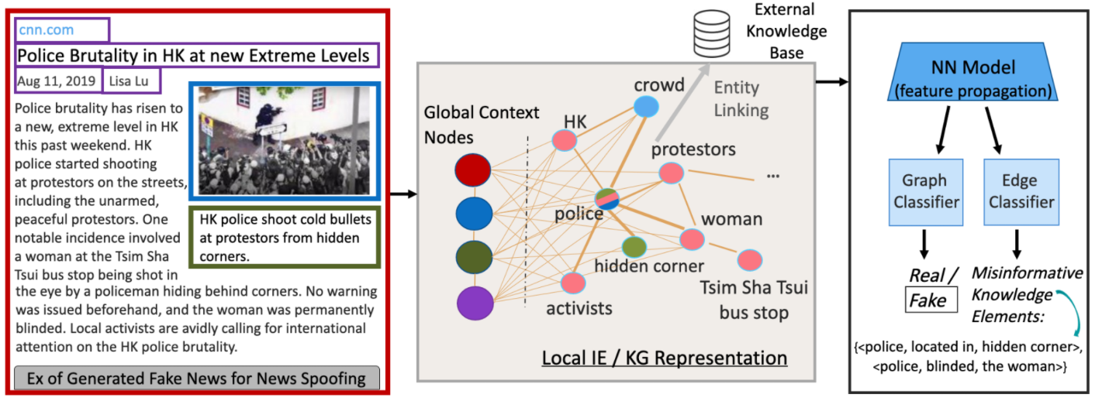
INFOSURGEON TECHNIQUE
Every news article’s component, such as a statement, image, title, publisher, and caption, is sorted into knowledge elements, and their significance is compared using a neural network.
This is a big step toward identifying latest news items and their originality in relation to the topic without the need for a reference.
Problem is that it is extremely vulnerable as Spammers and scammers can apply this research methods to create adversarial fake news and simply distribute falsehoods through infosurgeon without being caught.
Laos, the research does not incorporate sentimental analysis of the article or domain classification, which could lead to adversarial attacks due to the restricted dataset.
Notes:
news article’s are devided into Knowledge elements such as statement, image, title, publisher, and caption,
This is huge step to find exclusive news articles and find out they are genuine. Spammers and scammers can apply this research methods to create adversarial fake news

Slide 28
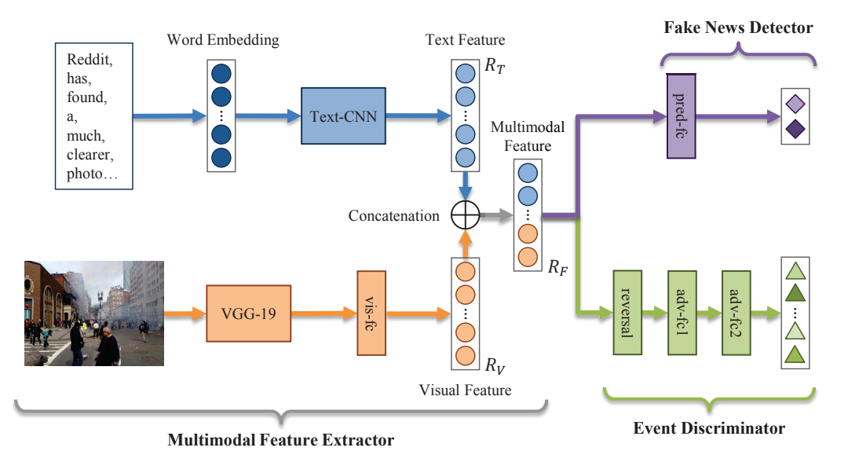
EVENT ADVERSARIAL NEURAL NETWORKS
This technique has been proven to be 10.3% more accurate than the Att-RNN models on Twitter and Weibo.
Takes into consideration both the visual and textual aspects of the Twitter message, allowing the model to confidently analyse and detect fake news.
Textual Feature Extractor:
Enhanced with convolution neural networks (CNN) and is very effective at classifying each word in the word embedding vector.
Text is vectorized and filtered, categorised, and grouped together.
Visual Feature Extractor:
This layer filter is effective in extracting images because it uses a pre-trained model to identify the images before fitting them into the matrix.
The main problem is that this neural network has only been tested on social media platforms like Twitter and Weibo and lacks the dataset and algorithmic capabilities to test for genuine published news stories.

Slide 29
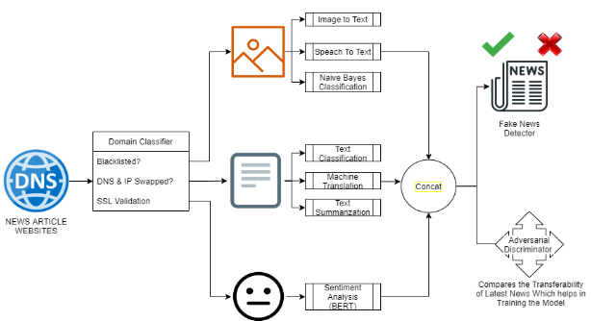
FUTURE RESEARCH OPPORTUNITIES
Natural Language Processing (NLP) Adversarial learning
There is a chance to make the classifiers more precise on the basis of BlackBox and Whitebox testing
Hotflip had a defect in recognising alternate words or deliberate spelling errors to trick the classifiers.
EANN technique is applied to news articles, which employs adversarial learning on both textual and visual data.
Adversarial Learning on ML systems for detection of Fake News
Notes:
There is a chance to make the classifiers more precise on the basis of BlackBox and Whitebox testing which involves making changes to the text to trick the classifiers and reduce the correctness of their responses. Hotflip, an existing text analysis technique, for instance, used to have a defect in recognising alternate words or deliberate spelling errors to trick the classifiers. These techniques were capable of evading machine learning spam filters and wreaking havoc. We will apply the EANN technique to news articles, which employs adversarial learning on both textual and visual data.

Slide 30
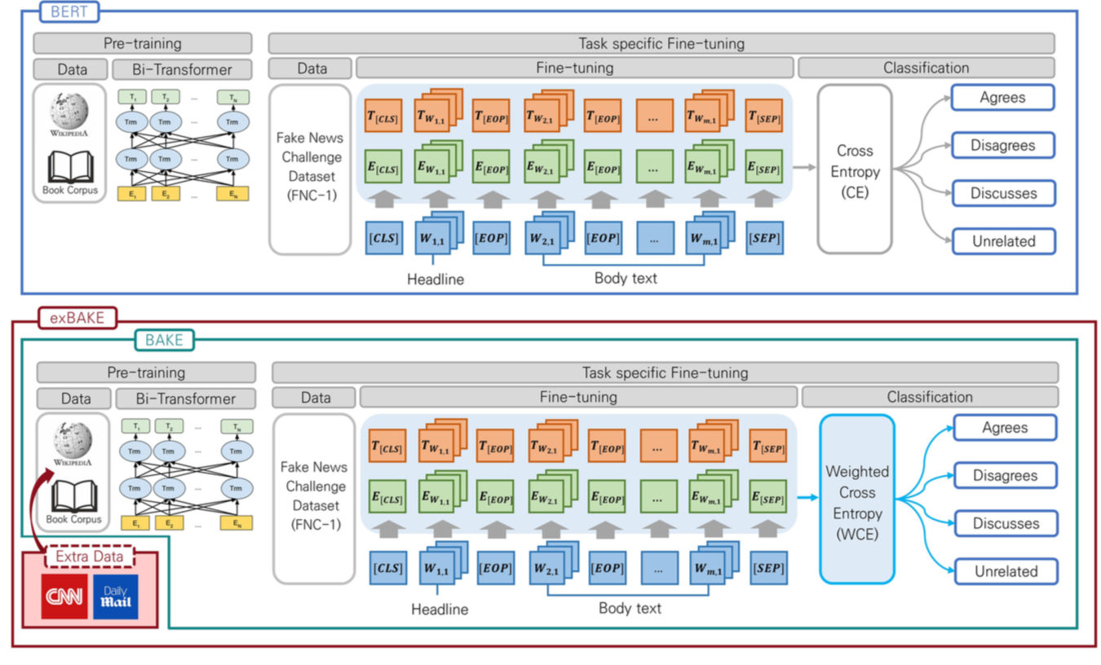
FUTURE RESEARCH OPPORTUNITIES
(contd/-....)
Addition of Sentimental Analysis
BERT has 12 encoder and 24 encoder models that collect statements in tokenized form and compare them to other statements. The sentimental analysis can be used in conjunction with other models to combine all of the results in order to improve the outcome of the fake new analysis.
exBAKE: Automatic Fake News Detection Model Based on Bidirectional Encoder Representations from Transformers (BERT)
BERT is used which includes pre-training language representations developed by Google.
Researchers found that the data was unstable, and therefore proposed to develop the BAKE model to classify the data using Weighted Cross Entropy (WCE).
CNN and Daily Mail news data were used for BAKE pre-training.
Finally,the performance of the proposed model exBAKE was evaluated.
Results indicated that the model worked best on the FNC-1 dataset, which detected fake news by analyzing the relationships between headlines and the corresponding body texts of news articles.
This Figure describes the BERT and exBAKE Model
Notes:
In this study, we included the CNN and Daily Mail datasets for additional learning during BERT’s pre-training stage to improve its detection capabilities. The data that the training and testing processes employ are used to fine-tune news articles. BERT’s pre-training exhibits good performance in other prior natural language processing (NLP) tasks. However, the data used in BERT model is based on 2500 M words of general data obtained from Wikipedia and 800 M words from the Book Corpus. While this data includes a wide range of information, it still lacks detailed information on individual domains. To address this shortcoming, news data have been added at the pre-training level in this study to improve its fake news detection capabilities.

Slide 31
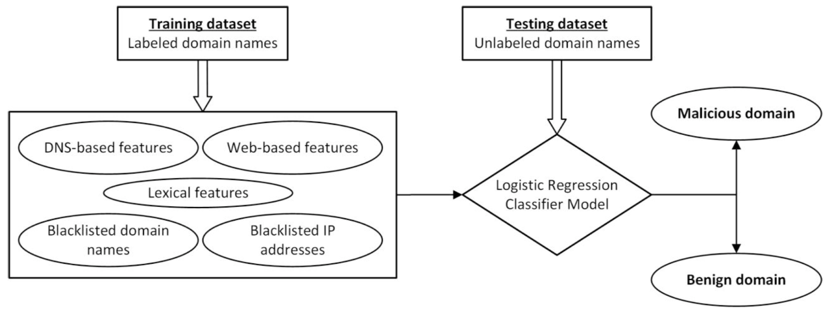
FUTURE RESEARCH OPPORTUNITIES
(contd/-....)
Domain Classifier
Malicious Domain Detection Using Machine Learning On Domain Name Features, Host-Based Features and Web-Based Features
Based on four features malicious domains were detected:
(a) Blacklist of domain names and IP addresses collated from reliable and reputed resources,
(b) DNS-based features extracted with support of various protocols which work on DNS infrastructure,
(c) Web-based features.
(d) Lexical features.
Approach adapted for malicious domain detection
Notes:
(c) Web-based features:
Attribute Description
Global and Country ranking Alexa, a popular ranking service, provides reliable ranking to websites based on
Webpages The number of webpages. More the number of webpages and lack of broken links ensures authenticity of the host
Time spent by visitor A visitor spending relative high time in the website improves authenticity of the host
Web referrals More the number of web referrals of a website in other Internet resources improves the credibility of the website
Web traffic (a) The consistency in the number of visitors to the website adds to the trustworthiness of the website
(b) Number of page views and
(c) amount of traffic reaching it through search engines
Category Identify the category or the subject matter to which the domain name belongs
Geo-location Geo-location of the IP addresses on which the domain name is hosted
(d) Lexical features:
Attribute Description
Dots Number of dots in the domain name should not be greater than 3
Underscores and hyphens Total count of underscores and hyphens in the domain name to be less than 4
Digits Count of number of digits in the domain name to be less than 4
Illegitimate contents We prepared a list of illegitimate words

Slide 32
FURTHER RESEARCH PLAN
Propose a new methodology to detect Fake News in Articles.
Obtain higher technical benchmarks with Adversarial methods of Fake News detection.
Developing new prospective towards is detection of Fake News.
Task/Milestone | Description | Date
Draft 1 Survey | Initial review of Fake News Detection addition of Actual Fake New Comparison table for detection techniques Addition of Fact Checking | 10th December 2021
Final Draft 2 Survey | New Prospective More research on generators New Future Research on SPO methodology | 24st December 2021
Technical Review | More improvement | Spring 2022
Final Publication 2 | TBH | December 2021

Slide 33

ANY QUESTIONS?

Slide 34

THANK YOU

